Slide 1
Maximum Likelihood Estimation in Stata

Slide 2
Introduction to MLE
Stata has a built-in language to write ML estimators. It uses this language to write many of its built-in commands
  e.g. probit, tobit, logit, clogit, glm, xtpoisson, etc.
I find the language very easy-to-use. For simple log-likelihood functions (especially those that are linear in the log-likelihood of each observation), implementation is trivial and the built-in maximization routines are good
Why should you use Stata ML?
  Stata will automatically calculate numerical gradients for you during each maximization step
  Have access to Stata’s syntax for dealing with panel data sets (for panel MLE this can result in very easy-to-read code)‏
  Can use as a first-pass to quickly evaluate whether numerical gradients/Hessians are going to work, or whether the likelihood surface is too difficult to maximize.
Why shouldn’t you use Stata ML?
  Maximization options are limited (standard Newton-Raphson and BHHH are included, but more recent algorithms not yet programmed)‏
  Tools to guide search over difficult likelihood functions aren’t great

Slide 3
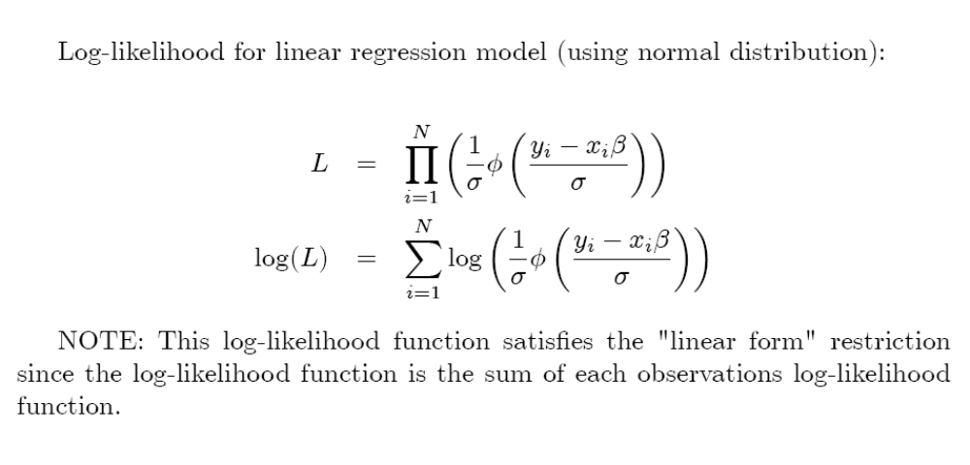
ML with linear model and
normal errors

Slide 4
Basic Stata ML
program drop _all
program mynormal_lf
args lnf mu
qui replace `lnf' = log(normalden(($ML_y1 - `mu’))
end
clear
set obs 100
set seed 12345
gen x = invnormal(uniform())
gen y = 2*x + invnormal(uniform())
ml model lf mynormal_lf (y = x)()
ml maximize
reg y x

Slide 5
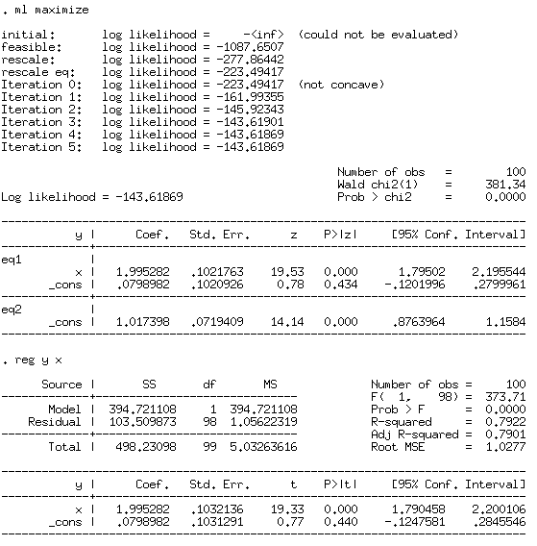

Slide 6
ML with linear regression
program drop _all
program mynormal_lf
args lnf mu sigma
qui replace `lnf' = log((1/`sigma')*normden(($ML_y1-`mu')/`sigma'))‏
end
clear
set obs 100
set seed 12345
gen x = invnormal(uniform())‏
gen y = 2*x + x*x*invnormal(uniform())‏
gen keep = (uniform() > 0.1)‏
gen weight = uniform()‏
ml model lf mynormal_lf (y = x) () [aw=weight] if keep == 1, robust
ml maximize
reg y x [aw=weight] if keep == 1, robust

Slide 7
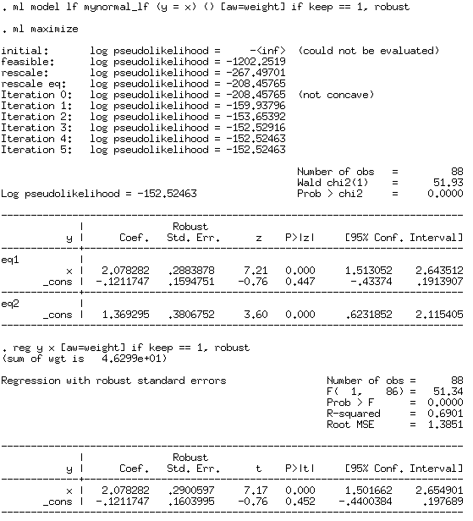

Slide 8
What’s going on in the background?
We just wrote a 3 (or 5) line program. What does Stata do with it?
When we call “ml maximize” it does the following steps:
  Initializes the parameters (the “betas”) to all zeroes
  As long as it has not declared convergence
    Calculates the gradient at the current parameter value
    Takes a step
    Updates parameters
    Test for convergence (based on either gradient, Hessian, or combination)‏
  Displays the parameters as regression output (ereturn!)‏

Slide 9
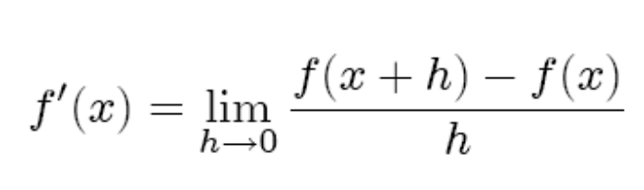
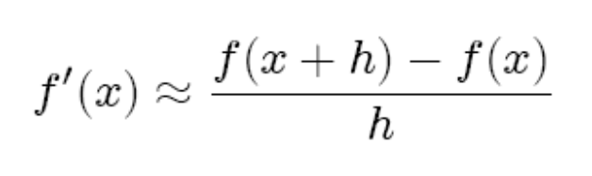

How does it calculate gradient?
Since we did not program a gradient, Stata will calculate gradients numerically. It will calculate a gradient by finding a numerical derivative.
Review:
  Analytic derivative is the following:
  So that leads to a simple approximation formula for “suitably small but large enough h”; this is a numerical derivative of a function:
  Stata knows how to choose a good “h” and in general it gets it right
Stata updates its parameter guess using the numerical derivatives as follows (i.e. it takes a “Newton” step):

Slide 10
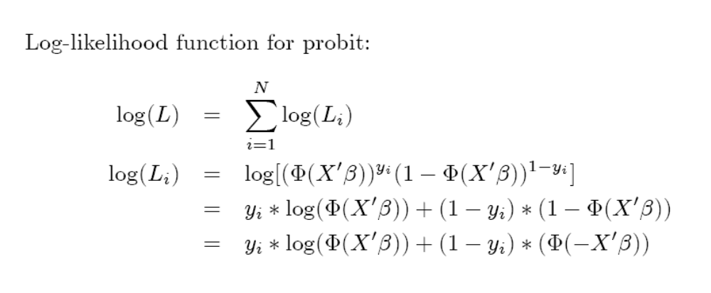
probit

Slide 11
Back to Stata ML (myprobit)‏
program drop _all
program myprobit_lf
args lnf xb
qui replace `lnf' = ln(norm( `xb')) if $ML_y1 == 1
qui replace `lnf' = ln(norm(-1*`xb')) if $ML_y1 == 0
end
clear
set obs 1000
set seed 12345
gen x = invnormal(uniform())‏
gen y = (0.5 + 0.5*x > invnormal(uniform()))‏
ml model lf myprobit_lf (y = x)‏
ml maximize
probit y x

Slide 12
TMTOWTDI!
program drop _all
program myprobit_lf
args lnf xb
qui replace `lnf' = ///
$ML_y1*ln(norm(`xb')) + (1-$ML_y1)*(1 - ln(norm(`xb')))
end
clear
set obs 1000
set seed 12345
gen x = invnormal(uniform())‏
gen y = (0.5 + 0.5*x > invnormal(uniform()))‏
ml model lf myprobit_lf (y = x)‏
ml maximize
probit y x

Slide 13
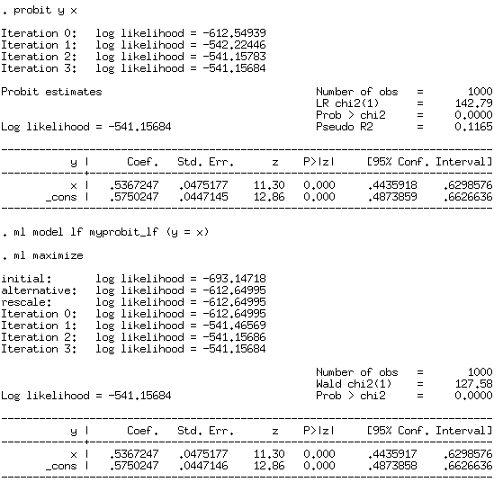

Slide 14
What happens here?
program drop _all
program myprobit_lf
args lnf xb
qui replace `lnf' = ln(norm( `xb')) if $ML_y1 == 1
qui replace `lnf' = ln(norm(-1*`xb')) if $ML_y1 == 0
end
clear
set obs 1000
set seed 12345
gen x = invnormal(uniform())‏
gen y = (0.5 + 0.5*x > invnormal(uniform()))‏
ml model lf myprobit_lf (y = x) ()‏
ml maximize
probit y x

Slide 15
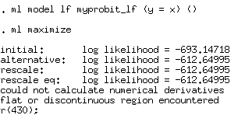
Difficult likelihood functions?
Stata will give up if it can’t calculate numerical derivatives. This can be a big pain, especially if it’s a long-running process and happens after a long time. If this is not a bug in your code (like last slide), a lot of errors like this is a sign to leave Stata so that you can get better control of the maximization process.
A key skill is figuring whether the error above is “bug” in your program or if it is a difficult likelihood function to maximize.

Slide 16
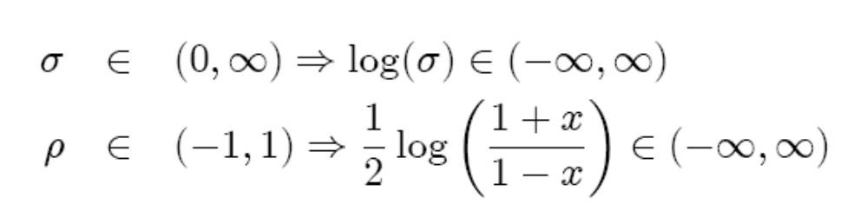
Transforming parameters
program drop _all
program mynormal_lf
args lnf mu ln_sigma
tempvar sigma
gen double `sigma' = exp(`ln_sigma')‏
qui replace `lnf' = log((1/`sigma')*normden(($ML_y1-`mu')/`sigma'))‏
end
clear
set obs 100
set seed 12345
gen x = invnormal(uniform())‏
gen y = 2*x + 0.01*invnormal(uniform())‏
ml model lf mynormal_lf (y = x) /log_sigma
ml maximize
reg y x

Slide 17
From “lf” to “d0”, “d1”, and “d2”
In some (rare) cases you will want to code the gradient (and possibly) the Hessian by hand. If there are simple analytic formulas for these and/or you need more speed and/or the numerical derivatives are not working out very well, this can be a good thing to do.
Every ML estimator we have written so far has been of type “lf”. In order to calculate analytic gradients, we need to use a “d1” or a “d2” ML estimator
But before we can implement the analytic formulas for the gradient and Hessian in CODE, we need to derive the analytic formulas themselves.

Slide 18
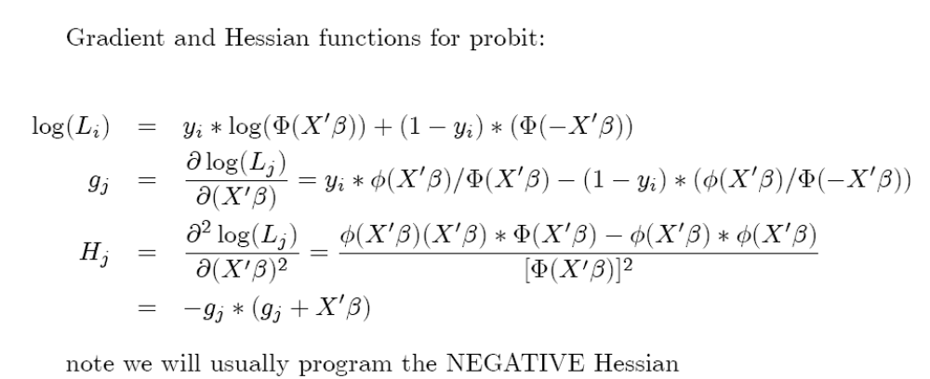
gradient and Hessian for probit

Slide 19
More probit (d0)‏
program drop _all
program myprobit_d0
args todo b lnf
tempvar xb l_j
mleval `xb' = `b'
qui {
gen `l_j' = normalden( `xb') if $ML_y1 == 1
replace `l_j' = normalden(-1 * `xb') if $ML_y1 == 0
mlsum `lnf' = ln(`l_j')‏
}
end
clear
set obs 1000
set seed 12345
gen x = invnormal(uniform())‏
gen y = (0.5 + 0.5*x > invnormal(uniform()))‏
ml model d0 myprobit_d0 (y = x)‏
ml maximize
probit y x

Slide 20
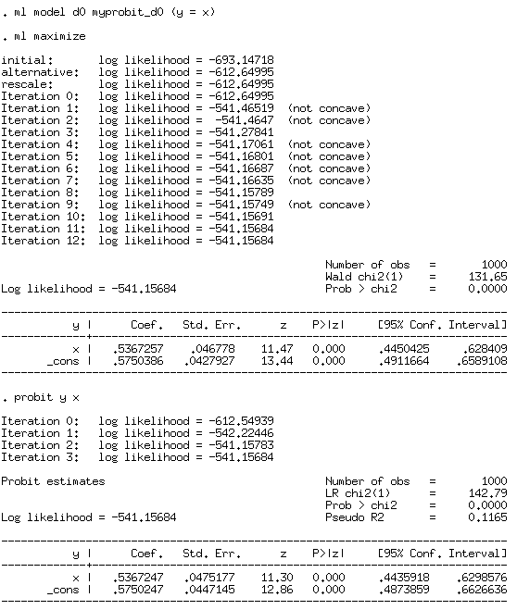

Slide 21
More probit (d0)‏
program drop _all
program myprobit_d0
args todo b lnf
tempvar xb l_j
mleval `xb' = `b'
qui {
gen double `l_j' = norm( `xb') if $ML_y1 == 1
replace `l_j' = norm(-1 * `xb') if $ML_y1 == 0
mlsum `lnf' = ln(`l_j')‏
}
end
clear
set obs 1000
set seed 12345
gen x = invnormal(uniform())‏
gen y = (0.5 + 0.5*x > invnormal(uniform()))‏
ml model d0 myprobit_d0 (y = x)‏
ml maximize
probit y x

Slide 22
Still more probit (d1)‏
program drop _all
program myprobit_d1
args todo b lnf g
tempvar xb l_j g1
mleval `xb' = `b'
qui {
gen double `l_j' = norm( `xb') if $ML_y1 == 1
replace `l_j' = norm(-1 * `xb') if $ML_y1 == 0
mlsum `lnf' = ln(`l_j')‏
gen double `g1' = normden(`xb')/`l_j' if $ML_y1 == 1
replace `g1' = -normden(`xb')/`l_j' if $ML_y1 == 0
mlvecsum `lnf' `g' = `g1', eq(1)‏
}
end
clear
set obs 1000
set seed 12345
gen x = invnormal(uniform())‏
gen y = (0.5 + 0.5*x > invnormal(uniform()))‏
ml model d1 myprobit_d1 (y = x)‏
ml maximize
probit y x

Slide 23
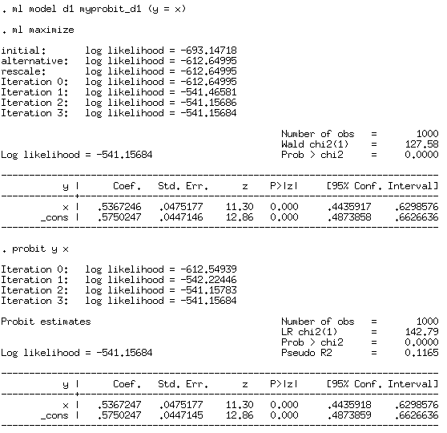

Slide 24
Last probit, I promise (d2)‏
program drop _all
program myprobit_d2
args todo b lnf g negH
tempvar xb l_j g1
mleval `xb' = `b'
qui {
gen double `l_j' = norm( `xb') if $ML_y1 == 1
replace `l_j' = norm(-1 * `xb') if $ML_y1 == 0
mlsum `lnf' = ln(`l_j')‏
gen double `g1' = normden(`xb')/`l_j' if $ML_y1 == 1
replace `g1' = -normden(`xb')/`l_j' if $ML_y1 == 0
mlvecsum `lnf' `g' = `g1', eq(1)‏
mlmatsum `lnf' `negH' = `g1'*(`g1'+`xb'), eq(1,1)‏
}
end
clear
set obs 1000
set seed 12345
gen x = invnormal(uniform())‏
gen y = (0.5 + 0.5*x > invnormal(uniform()))‏
ml model d2 myprobit_d2 (y = x)‏
ml search
ml maximize
probit y x

Slide 25
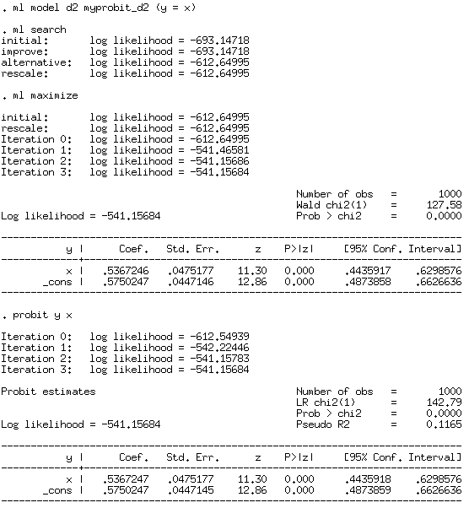

Slide 26
Beyond linear-form likelihood fn’s
Many ML estimators I write down do NOT satisfy the linear-form restriction, but OFTEN they have a simple panel structure (e.g. think of any “xt*” command in Stata that is implemented in ML)‏
Stata has nice intuitive commands to deal with panels (e.g. “by” command!) that work inside ML programs
As an example, let’s develop a random-effects estimator in Stata ML. This likelihood function does NOT satisfy the linear-form restriction (i.e. the overall log-likelihood function is NOT just the sum of the individual log-likelihood functions)‏
This has two purposes:
  More practice going from MATH to CODE
  Good example of a panel data ML estimator implementation

Slide 27
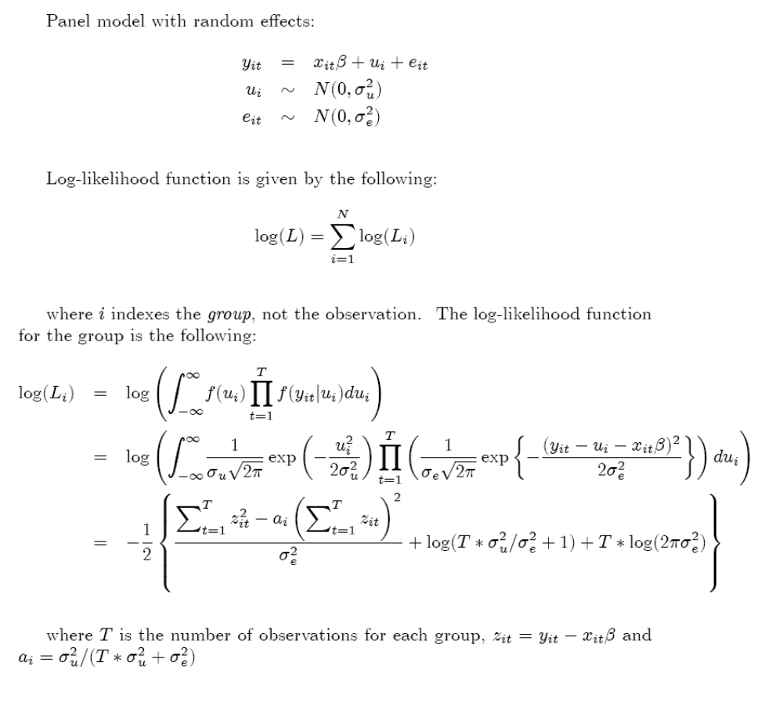

Slide 28
Random effects in ML
program drop _all
program define myrereg_d0
args todo b lnf
tempvar xb z T S_z2 Sz_2 S_temp a first
tempname sigma_u sigma_e ln_sigma_u ln_sigma_e
mleval `xb' = `b', eq(1)‏
mleval `ln_sigma_u' = `b', eq(2) scalar
mleval `ln_sigma_e' = `b', eq(3) scalar
scalar `sigma_u' = exp(`ln_sigma_u')‏
scalar `sigma_e' = exp(`ln_sigma_e')‏
** hack!
sort $panel
qui {
gen double `z' = $ML_y1 - `xb'
by $panel: gen `T' = _N
gen double `a' = (`sigma_u'^2) / (`T'*(`sigma_u'^2) + `sigma_e'^2)‏
by $panel: egen double `S_z2' = sum(`z'^2)‏
by $panel: egen double `S_temp' = sum(`z')‏
by $panel: gen double `Sz_2' = `S_temp'^2
by $panel: gen `first' = (_n == 1)‏
mlsum `lnf' = -.5 * ///
( (`S_z2' - `a'*`Sz_2')/(`sigma_e'^2) + ///
log(`T'*`sigma_u'^2/`sigma_e'^2 + 1) + ///
`T'*log(2* _pi * `sigma_e'^2) ///
) if `first' == 1
}
end

Slide 29
Random effects in ML
program drop _all
program define myrereg_d0
args todo b lnf
tempvar xb z T S_z2 Sz_2 S_temp a first
tempname sigma_u sigma_e ln_sigma_u ln_sigma_e
mleval `xb' = `b', eq(1)‏
mleval `ln_sigma_u' = `b', eq(2) scalar
mleval `ln_sigma_e' = `b', eq(3) scalar
scalar `sigma_u' = exp(`ln_sigma_u')‏
scalar `sigma_e' = exp(`ln_sigma_e')‏
** hack!
sort $panel
qui {
gen double `z' = $ML_y1 - `xb'
by $panel: gen `T' = _N
gen double `a' = (`sigma_u'^2) / (`T'*(`sigma_u'^2) + `sigma_e'^2)‏
by $panel: egen double `S_z2' = sum(`z'^2)‏
by $panel: egen double `S_temp' = sum(`z')‏
by $panel: gen double `Sz_2' = `S_temp'^2
by $panel: gen `first' = (_n == 1)‏
mlsum `lnf' = -.5 * ///
( (`S_z2' - `a'*`Sz_2')/(`sigma_e'^2) + ///
log(`T'*`sigma_u'^2/`sigma_e'^2 + 1) + ///
`T'*log(2* _pi * `sigma_e'^2) ///
) if `first' == 1
}
end

Slide 30
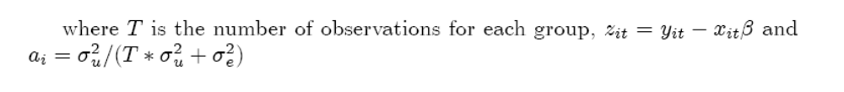
Random effects in ML
program drop _all
program define myrereg_d0
args todo b lnf
tempvar xb z T S_z2 Sz_2 S_temp a first
tempname sigma_u sigma_e ln_sigma_u ln_sigma_e
mleval `xb' = `b', eq(1)‏
mleval `ln_sigma_u' = `b', eq(2) scalar
mleval `ln_sigma_e' = `b', eq(3) scalar
scalar `sigma_u' = exp(`ln_sigma_u')‏
scalar `sigma_e' = exp(`ln_sigma_e')‏
** hack!
sort $panel
qui {
gen double `z' = $ML_y1 - `xb'
by $panel: gen `T' = _N
gen double `a' = (`sigma_u'^2) / (`T'*(`sigma_u'^2) + `sigma_e'^2)‏
by $panel: egen double `S_z2' = sum(`z'^2)‏
by $panel: egen double `S_temp' = sum(`z')‏
by $panel: gen double `Sz_2' = `S_temp'^2
by $panel: gen `first' = (_n == 1)‏
mlsum `lnf' = -.5 * ///
( (`S_z2' - `a'*`Sz_2')/(`sigma_e'^2) + ///
log(`T'*`sigma_u'^2/`sigma_e'^2 + 1) + ///
`T'*log(2* _pi * `sigma_e'^2) ///
) if `first' == 1
}
end

Slide 31
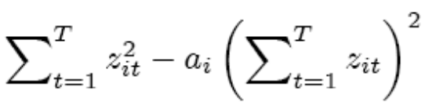
Random effects in ML
program drop _all
program define myrereg_d0
args todo b lnf
tempvar xb z T S_z2 Sz_2 S_temp a first
tempname sigma_u sigma_e ln_sigma_u ln_sigma_e
mleval `xb' = `b', eq(1)‏
mleval `ln_sigma_u' = `b', eq(2) scalar
mleval `ln_sigma_e' = `b', eq(3) scalar
scalar `sigma_u' = exp(`ln_sigma_u')‏
scalar `sigma_e' = exp(`ln_sigma_e')‏
** hack!
sort $panel
qui {
gen double `z' = $ML_y1 - `xb'
by $panel: gen `T' = _N
gen double `a' = (`sigma_u'^2) / (`T'*(`sigma_u'^2) + `sigma_e'^2)‏
by $panel: egen double `S_z2' = sum(`z'^2)‏
by $panel: egen double `S_temp' = sum(`z')‏
by $panel: gen double `Sz_2' = `S_temp'^2
by $panel: gen `first' = (_n == 1)‏
mlsum `lnf' = -.5 * ///
( (`S_z2' - `a'*`Sz_2')/(`sigma_e'^2) + ///
log(`T'*`sigma_u'^2/`sigma_e'^2 + 1) + ///
`T'*log(2* _pi * `sigma_e'^2) ///
) if `first' == 1
}
end

Slide 32
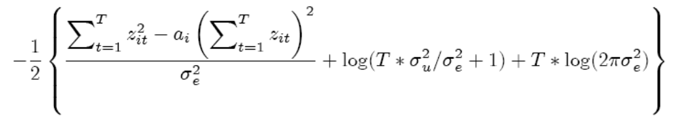
Random effects in ML
program drop _all
program define myrereg_d0
args todo b lnf
tempvar xb z T S_z2 Sz_2 S_temp a first
tempname sigma_u sigma_e ln_sigma_u ln_sigma_e
mleval `xb' = `b', eq(1)‏
mleval `ln_sigma_u' = `b', eq(2) scalar
mleval `ln_sigma_e' = `b', eq(3) scalar
scalar `sigma_u' = exp(`ln_sigma_u')‏
scalar `sigma_e' = exp(`ln_sigma_e')‏
** hack!
sort $panel
qui {
gen double `z' = $ML_y1 - `xb'
by $panel: gen `T' = _N
gen double `a' = (`sigma_u'^2) / (`T'*(`sigma_u'^2) + `sigma_e'^2)‏
by $panel: egen double `S_z2' = sum(`z'^2)‏
by $panel: egen double `S_temp' = sum(`z')‏
by $panel: gen double `Sz_2' = `S_temp'^2
by $panel: gen `first' = (_n == 1)‏
mlsum `lnf' = -.5 * ///
( (`S_z2' - `a'*`Sz_2')/(`sigma_e'^2) + ///
log(`T'*`sigma_u'^2/`sigma_e'^2 + 1) + ///
`T'*log(2* _pi * `sigma_e'^2) ///
) if `first' == 1
}
end

Slide 33
Random effects in ML
program drop _all
program define myrereg_d0
args todo b lnf
tempvar xb z T S_z2 Sz_2 S_temp a first
tempname sigma_u sigma_e ln_sigma_u ln_sigma_e
mleval `xb' = `b', eq(1)‏
mleval `ln_sigma_u' = `b', eq(2) scalar
mleval `ln_sigma_e' = `b', eq(3) scalar
scalar `sigma_u' = exp(`ln_sigma_u')‏
scalar `sigma_e' = exp(`ln_sigma_e')‏
** hack!
sort $panel
qui {
gen double `z' = $ML_y1 - `xb'
by $panel: gen `T' = _N
gen double `a' = (`sigma_u'^2) / (`T'*(`sigma_u'^2) + `sigma_e'^2)‏
by $panel: egen double `S_z2' = sum(`z'^2)‏
by $panel: egen double `S_temp' = sum(`z')‏
by $panel: gen double `Sz_2' = `S_temp'^2
by $panel: gen `first' = (_n == 1)‏
mlsum `lnf' = -.5 * ///
( (`S_z2' - `a'*`Sz_2')/(`sigma_e'^2) + ///
log(`T'*`sigma_u'^2/`sigma_e'^2 + 1) + ///
`T'*log(2* _pi * `sigma_e'^2) ///
) if `first' == 1
}
end

Slide 34
Random effects in ML
clear
set obs 100
set seed 12345
gen x = invnormal(uniform())‏
gen id = 1 + floor((_n - 1)/10)‏
bys id: gen fe = invnormal(uniform())‏
bys id: replace fe = fe[1]
gen y = x + fe + invnormal(uniform())‏
global panel = "id"
ml model d0 myrereg_d0 (y = x) /ln_sigma_u /ln_sigma_e
ml search
ml maximize
xtreg y x, i(id) re

Slide 35
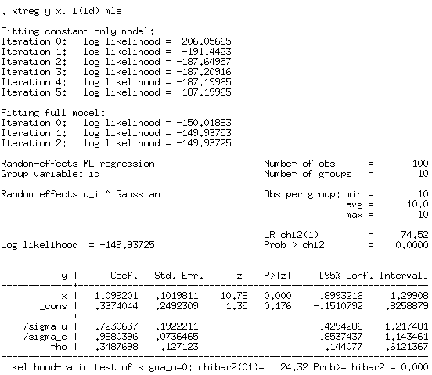
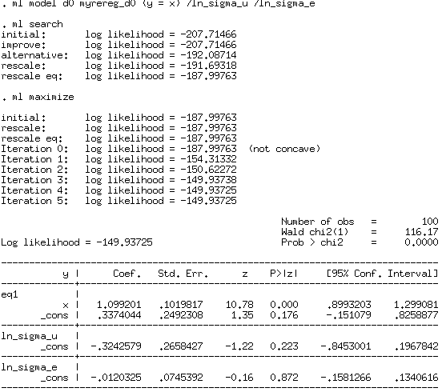
“my” MLE RE
vs.
XTREG, MLE
Point estimates identical but standard errors different; why?

Slide 36
Exercises
(A) Implement logit as a simple (i.e. “lf”) ML estimator using Stata’s ML language
(If you have extra time, implement as a d2 estimator, calculating the gradient and Hessian analytically)
(B) Implement conditional logit maximum likelihood (MLE) estimator using Stata’s ML language (NOTE: This is HARD; see hints on-line)

Slide 37
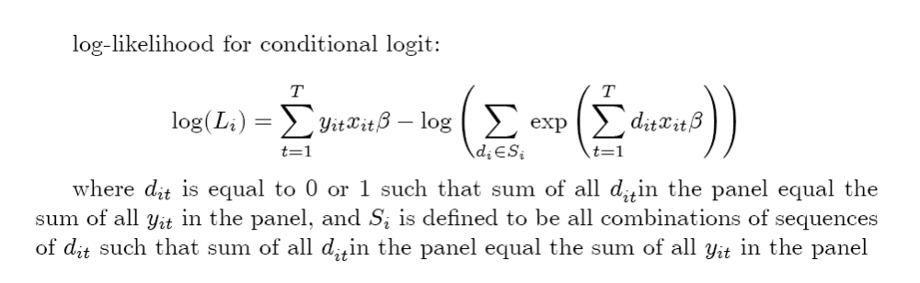
conditional logit

